Slide 1

Rage Quit October 12, 2020
The Fumbling Five
Team member names
Product Owner: Yong Lu
Initial Scrum Master: Victor Chung
Team: Jared Tran, Jeremy Euchi, Brooke Clement

Slide 2
Rage Quit
Having a bad day? Want to take out your rage and frustrations on expensive objects but can't because you're broke? No worries! With the Expensive Item Destruction Simulator, you can have the second-best option!
Idea: The simulator consists of you (the player) and expensive items. You break the items with various available tools. This project will use the Unity engine.

Slide 3
Project Scope
Priority One: Our minimum viable product will be a 3D style game.
Interactable Surroundings
First-person player experience
There will be a couple of items and accompanying tools to break these items. Each item will have different interactions and animations with each tool.
Priority Two: A house for the player to explore and breakable items inside. Particularly the player's room.
Priority Three: The player's room is customizable.
Priority Four: Coop/Multiplayer. (Destroy your friend's custom room)

Slide 4
Sprint 1
User Stories
As a player, I want a starting room to feel immersed.
As a player, I want interactive controls so that I can be able to move around the world and destroy objects.
As a player, I want a menu screen and a how to play screen.
Spikes
Check out the game Where is My Hammer or Kill it with fire in order to understand FPS mechanics.
Get familiar with Unity and C#
Learn Blender for the design of Models
Infrastructure Tasks
Install Unity and Visual Studio or code editor of choice

Slide 5
Sprint 2
User Stories
As a player, I want the environment I’m in to feel real. (Models and assets for the objects)
As a player, I want a sledgehammer to smash electronics.
Spikes
Research how to create custom Models and assets for objects
Look into possible premade assets
Infrastructure Tasks
Import necessary and appropriate 3D assets and models from available sources
Determine software (such as Blender) for creation of models and assets.

Slide 6
Sprint 3
User Stories
As a player, I want clear information on how to play and how to win. Basically an instructional UI.
As a player, I want to be able to use a bladed weapon to slice and dice apple products.
Spikes
Research and come to a consensus with a design for the “How to Play” menu.
research score menu and timer for the game.
Design UI/UX
Infrastructure Tasks
Install relevant Unity packages

Slide 7
Sprint 4
User Stories:
As a player, I want a polished and well-lit game.
As a player, I want to play with my friends.
As a player, I want to customize my room.
Spikes:
Do research on the lighting and post-processing
Look into implementation of multiplayer functions
research multiplayer functionality
Play testing and checking for bugs

Slide 8
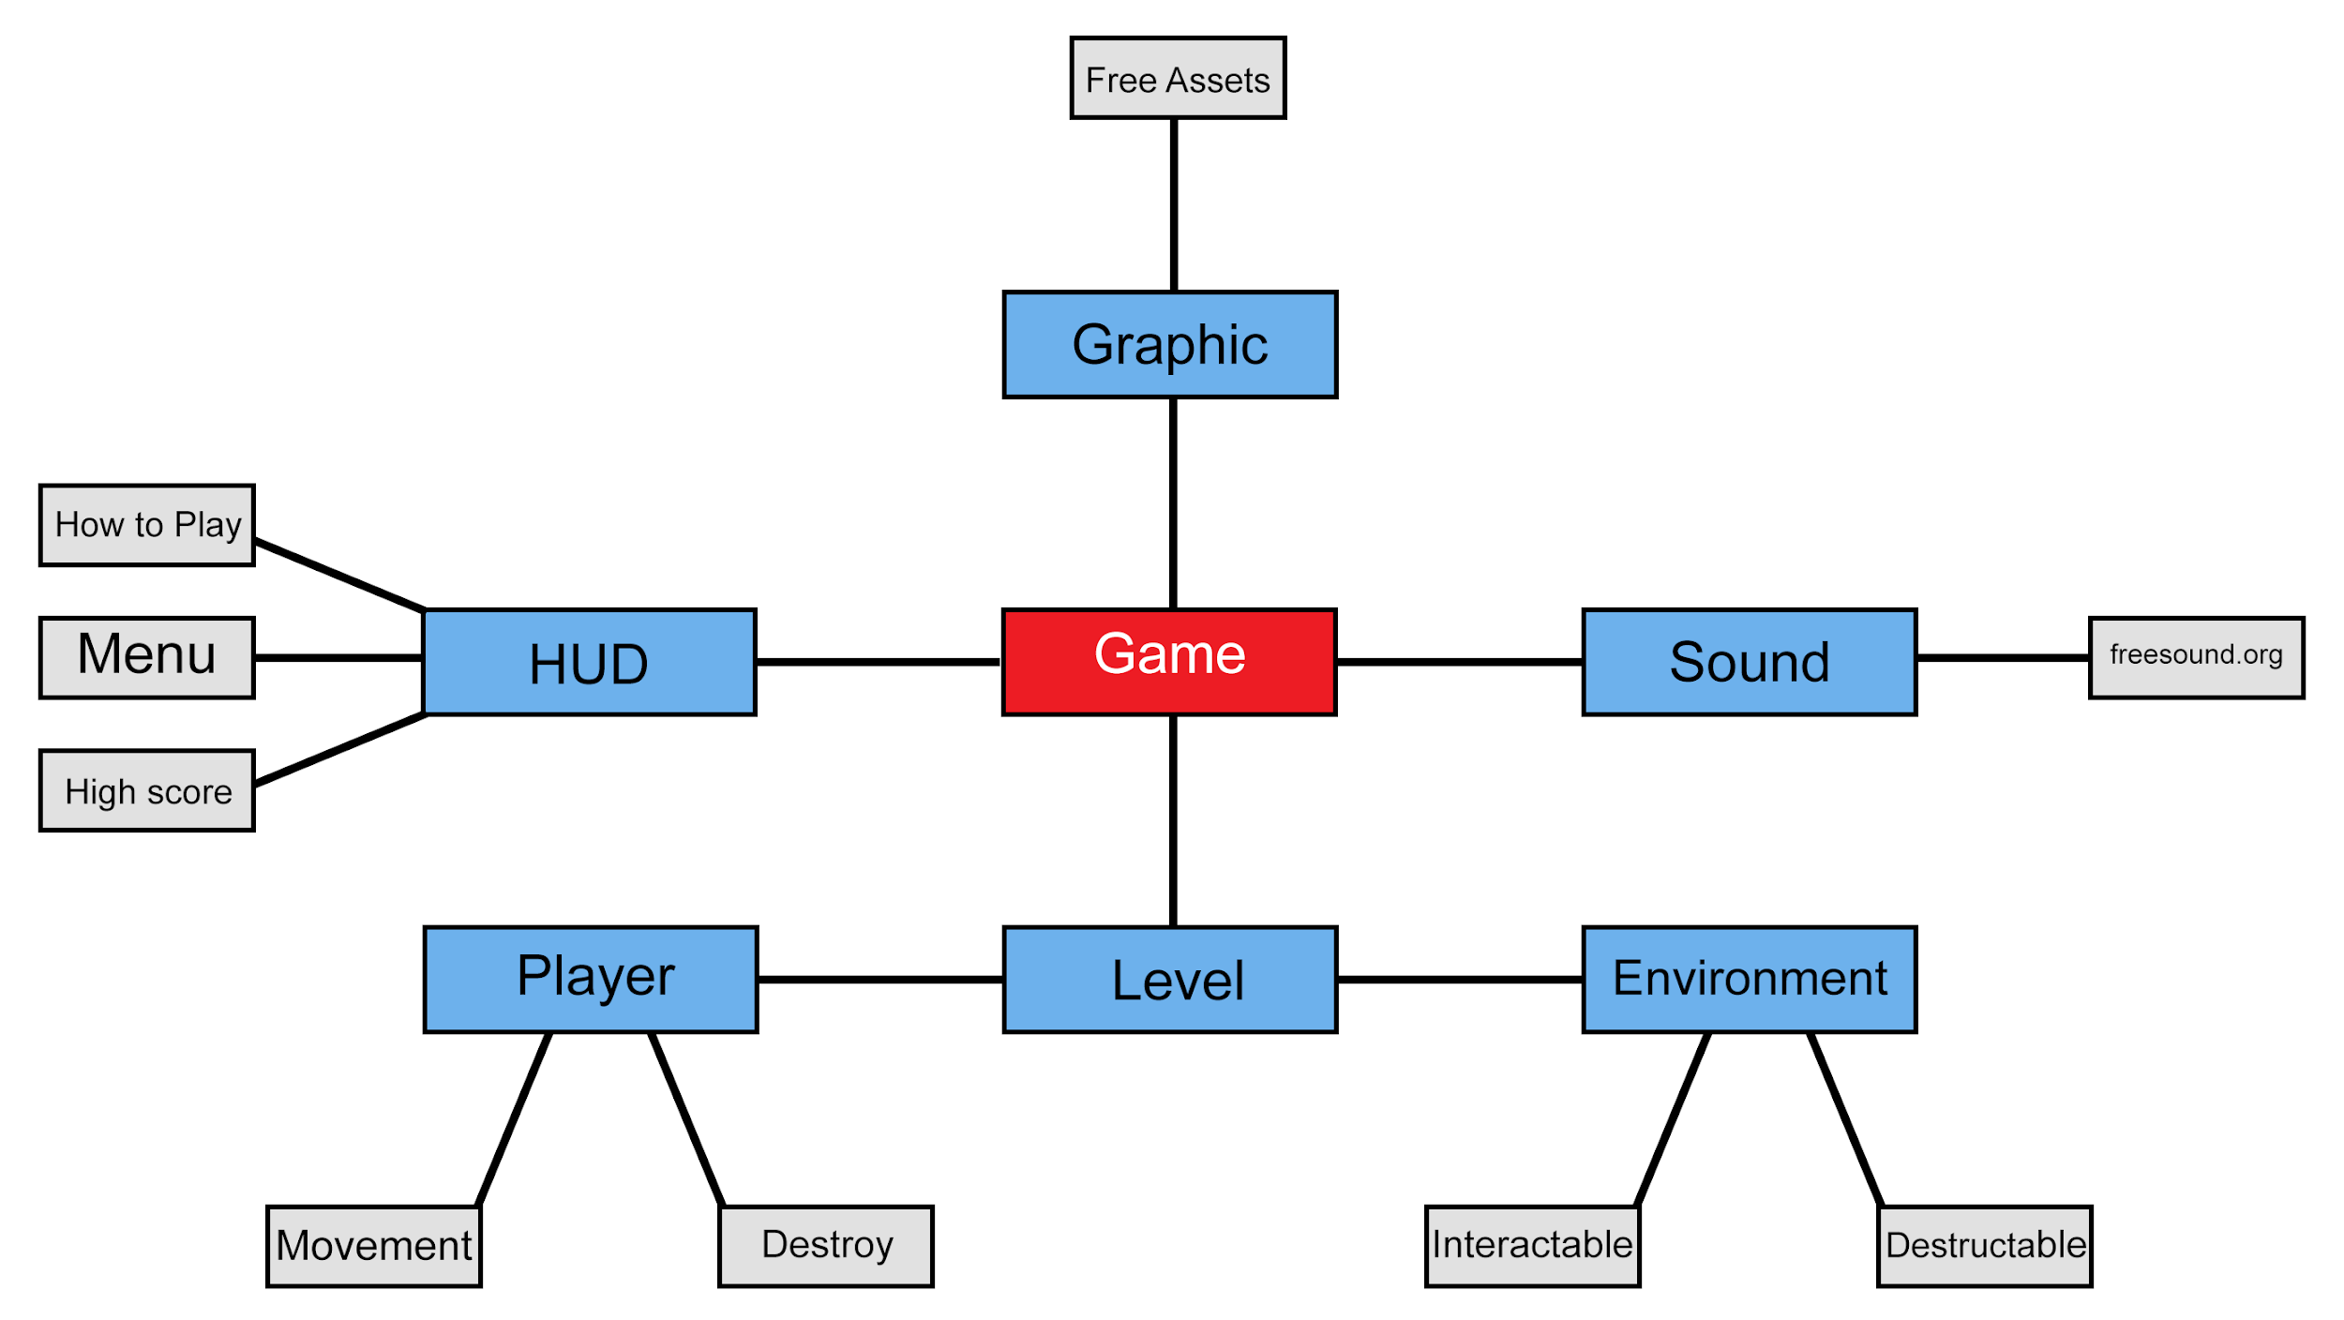
Architecture

Slide 9
Technologies
C#
Unity
Unity Teams
Blender

Slide 10
Challenges/Risks
Unfamiliar technology
Acquiring art assets. Creating art without an artist.
Working with the physics of objects
Juggling the learning of both Unity and Blender

Slide 11
Minimum Viable Product
First person 3D game
Game Menu for the player
Controls information menu for the player
Interactable Environment for the player
Objects that the player can destroy
Tools for the player to destroy the items with

